Slide 1
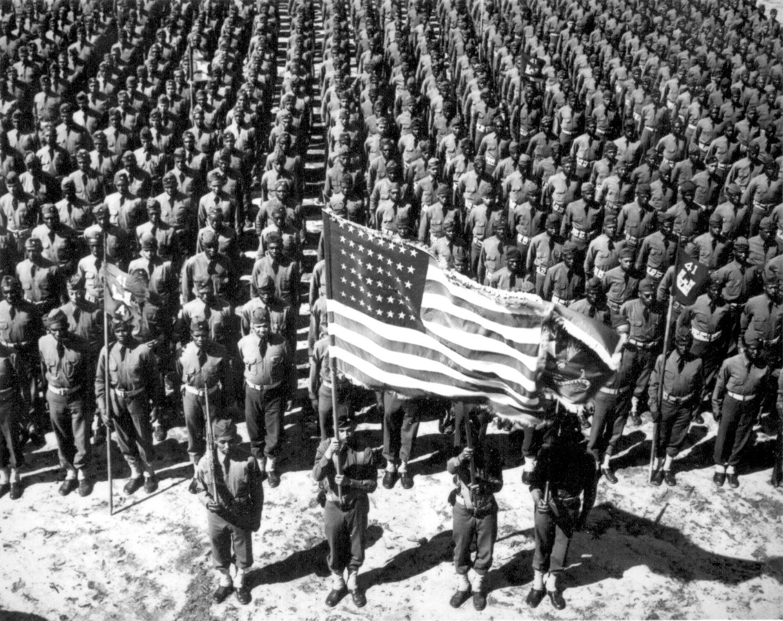
The Road to War
Part 1: The Rise of Totalitarianism Part 2: From Isolation to Involvement Part 3: The Giant Awakens

Slide 2
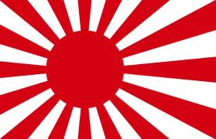
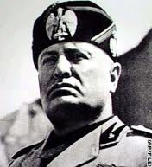
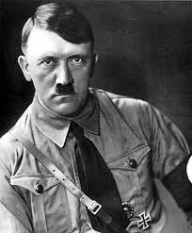
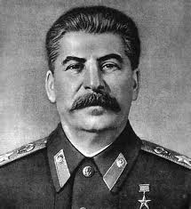
Part One:
“I believe it is peace for our time”
Neville Chamberlain
Prime Minister of Great Britain
September 30, 1938
Naval Battle Flag of the Empire of Japan
The Rise of Totalitarianism
Benito Mussolini
Adolf Hitler
Josef Stalin

Slide 3
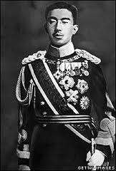
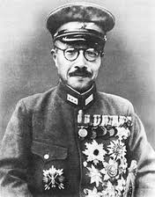
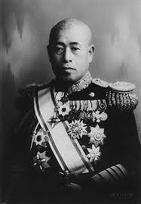
Japan
During this period, Japan is a “constitutional monarchy” headed by an Emperor.
The Depression causes the civilian government to become unpopular.
The Japanese constitution gave the Army and Navy too much power.
The military sees conquest as a means to stop the Depression.
Japan does not become totalitarian, however.
Simply militaristic and nationalistic.

Slide 4
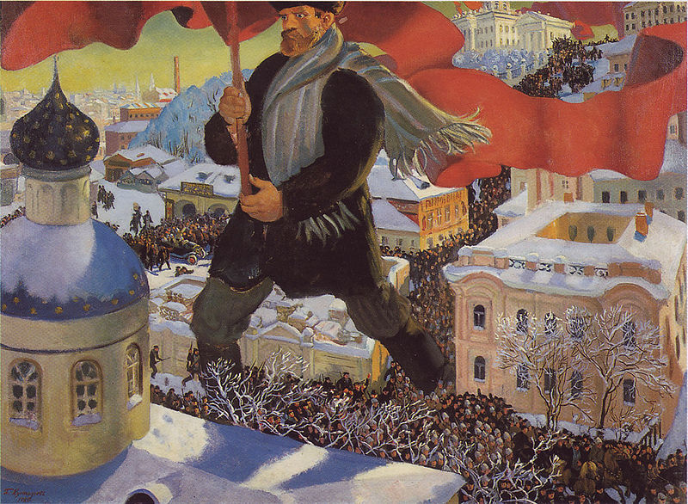
The Soviet Union (née: Russia)
Review: In 1917, near the end of World War I, a massive
communist revolution topples the Russian government.
Bolsheviks, as they are also known, seek peace with Germany.
This revolution leads to a “Red Scare” in the United States and Western Europe.

Slide 5
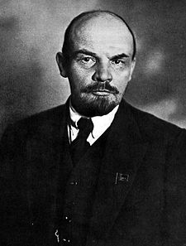
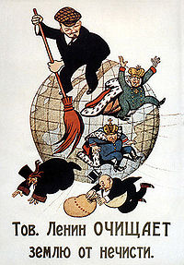
The Soviet Union (née: Russia)
Until 1924, the Soviet Union is run by Vladimir Lenin.
After a nearly successful assassination attempt, Lenin, at the suggestion of Josef Stalin, begins the “Red Terror.”
Red Terror: A campaign of murder and terrorization aimed at the political enemies of the Communist Party

Slide 6
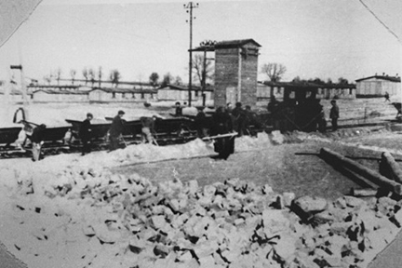
The Soviet Union (née: Russia)
In 1924, Lenin dies and is succeeded by Josef Stalin.
Stalin has almost absolute power over the Soviet State. He uses this power to attack political rivals.
Purges
(“The Great Terror”)
Labor Camps
(“Gulags”)
Secret Police
Censorship & Domestic Spying

Slide 7
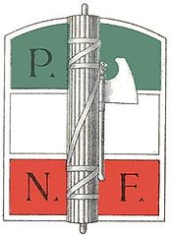
Italy
After World War I, Italy suffers.
Burdened by debts from the war.
Given no territories by the allies.
Weak and ineffective central government.
Depression means returning veterans have no jobs.
A growing Communist movement in Italy.
In 1919, Benito Mussolini forms the “Fascist Party.”
* Highly Nationalistic
* Anti-Communist & Anti-Socialist
* Anti-Democratic

Slide 8
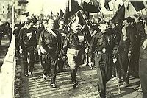
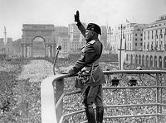
Italy
In 1924, Mussolini and his Black Shirts lead a coup d'état.
Mussolini is becomes “Il Duce” – “The Leader”

Slide 9
Italy
Within a few years, Mussolini is in total control of Italy.
Bans other political parties
Creates a Police State
State control of businesses
State control of the press
Heavy use of propaganda & terrorism to maintain power.
Flag of the Italian “Empire”

Slide 10
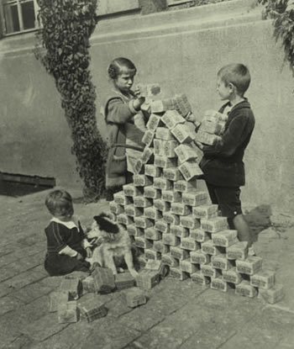
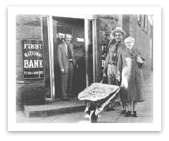
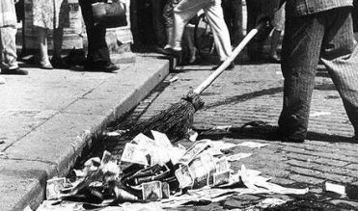
Germany
After the end of World War I, Germany has many, many problems.
Owes a ton of indemnities.
New Weimar government was unpopular
Public anger over Versailles Treaty
Hyperinflation

Slide 11
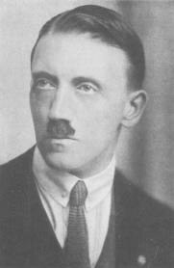
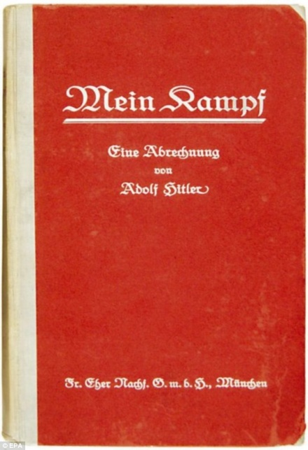
Germany
Many anti-democratic, right-wing political groups become popular. One of these groups is the Nazi Party.
A young Bavarian WWI veteran, Adolf Hitler, joins the party and rises to power quickly.
He attempts to emulate Mussolini’s success, and attempts to lead Coup d'état. The “Beer Hall Putsch” fails, and Hitler is jailed.
While in prison, he writes Mein Kampf, (“My Struggle”)

Slide 12
Germany
Mein Kampf lays out Hitler’s political philosophy.
German Jews are responsible for Germany’s defeat in WWI. (“Stabbed in the Back” myth)
Parliamentary democracy is a failure.
Communism and Socialism are existential threats to Germany.
The book was very popular, and it made Adolf Hitler into a national political figure.

Slide 13
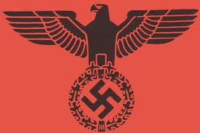
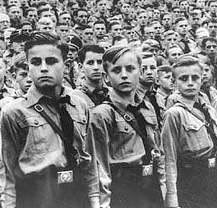
Germany
In 1933, Adolf Hitler is made Chancellor of Germany.
Consolidated all power in Nazi hands.
Used “Brown Shirts” to create unrest.
Banned other political parties.
Creates a secret police.
Despite this, Hitler was popular with many!
Remilitarization ends Germany’s depression.
State controlled media & education systems.

Slide 14
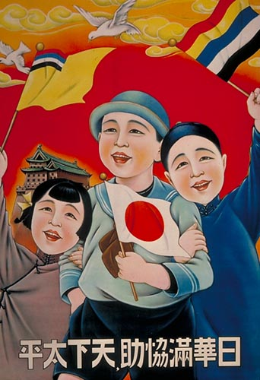
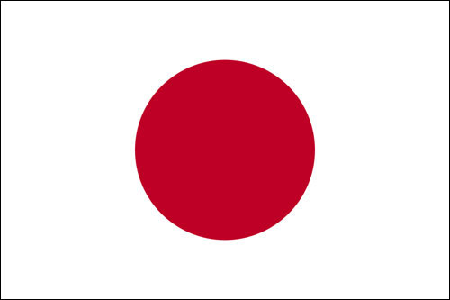
War Begins in Asia
Lacks raw materials needed for industry
Oil
Rubber
The only industrialized Asian nation
Believe they have been treated unfairly by European nations
Army and Navy control foreign policy
Japanese see themselves as rightful leaders of Asia & the Pacific Islands
Already control Korea and Taiwan
Occupies Manchuria in 1931
Invades China in 1937
“Rape of Nanjing”
The US & European nations don’t get involved
The Empire of Japan
“Greater East Asia Co-Prosperity Sphere”

Slide 15
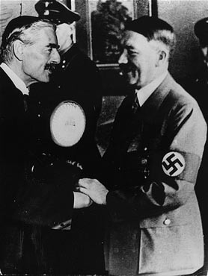
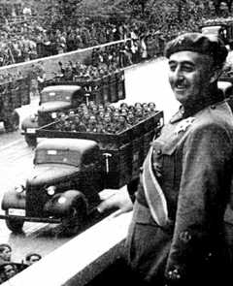
War Begins in Europe
Right-wing, Fascist “Nationalists” supported by Germany.
Republican government supported by USSR. (Soviet Union)
US, Britain, & France remain neutral
“Test Run” for WWII
Hitler claims the need for Lebensraum
Annexes Austria
Takes over German-speaking areas of Czechoslovakia
Mussolini invades Ethiopia
England & France do nothing
Spanish Civil War
Appeasement

Slide 16
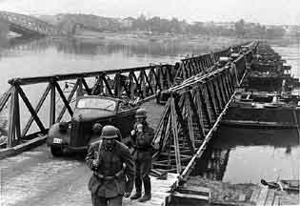
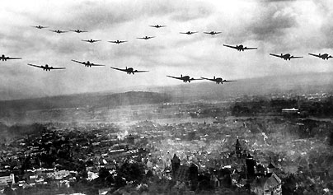
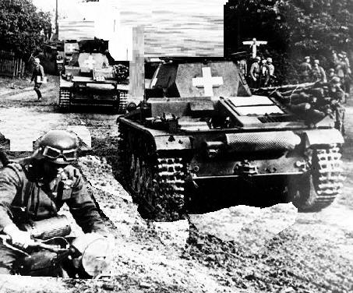
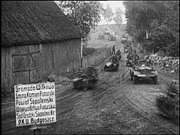
Germany invades Poland
1 September 1939

Slide 17
Part Two:
“This nation will remain a neutral nation, but I cannot ask that every American remain neutral in thought as well.”
Franklin D. Roosevelt
September 3, 1939
The United States: Isolation to Involvement

Slide 18
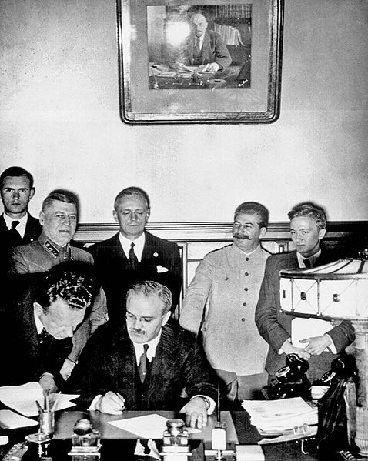
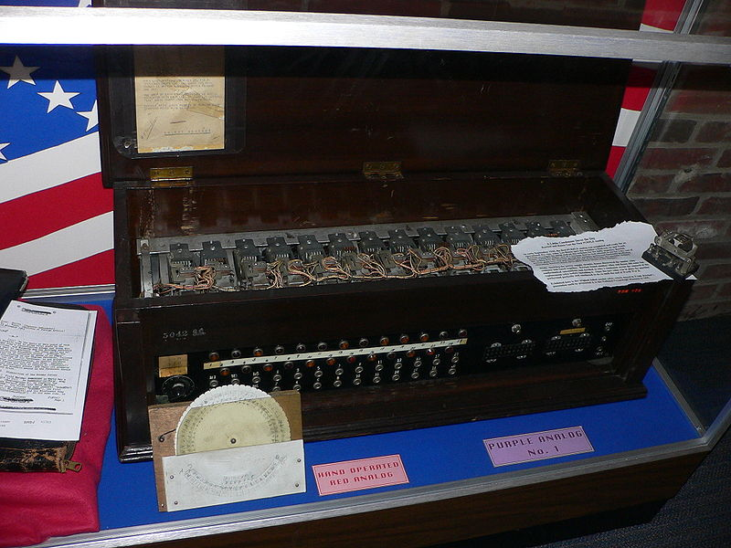
Isolationism Becomes Difficult
Britain & France ally with Poland – end appeasement
Germany signs nonaggression pact w/ USSR, secretly agree to split up Poland
9/1/39: Blitzkrieg into Poland. GB and France declare war.
9/17/39: USSR invades Poland.
1940: Alliance with Japan & Italy
U.S. and Japan are friendly after WWI
1931: Invasion of Manchuria sours relations
1937: Invasion of China further worsens them
1940: US begins to embargos oil, iron,& steel
Japan negotiates & prepares for war.
Relations with Japan
German Diplomacy

Slide 19
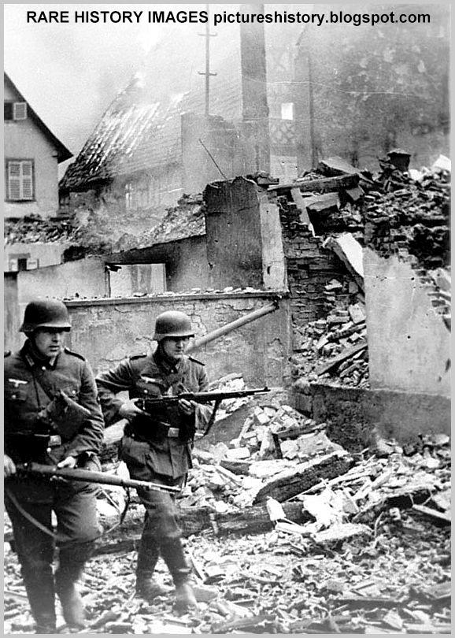
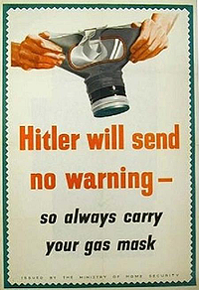
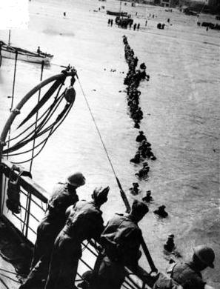
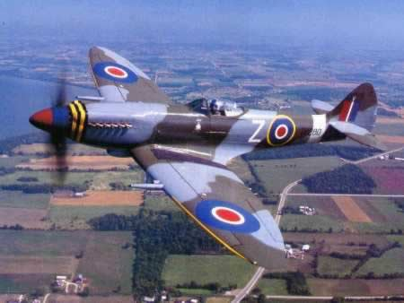
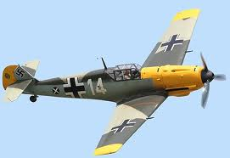
Isolationism Becomes Difficult
Poland falls in a month
8 Months of “Phony War”
April & May: Germany invades several small, neutral nations
Germany invades France through lightly defended Ardennes Forest.
France falls, but 330,000 soldiers escape by sea from Dunkirk
Invasion of England halted by Royal Air Force
War in Europe

Slide 20
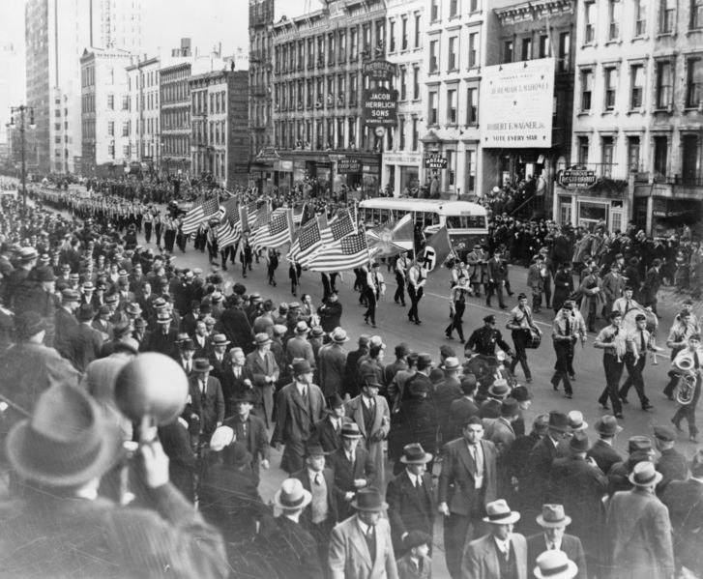
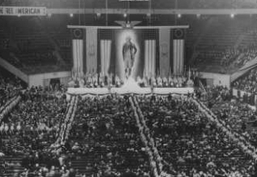
The Neutrality Acts
Passed by Congress, forces U.S. to stay Neutral
Roosevelt is openly Pro-Allies and Anti-Axis.
1st in 1939: Allows a “cash and carry” provision.
Some do not like the Pro-Allies policies
Major corporations are doing business w/Fascist nations
Many prominent Americans are Pro-German
Charles Lindbergh attends Nazi functions in Germany
Henry Ford funds Nazi activities & wins Nazi Award
German-American Bunds form all over U.S. – Mostly Immigrants

Slide 21
Growing Interventionism
Roosevelt runs for and wins a third term.
1st & Last time in U.S. History
Roosevelt begins more openly assisting Britain
Lend-Lease Act
In 1941, Churchill & Roosevelt sign Atlantic Charter
In response, Germany begins to attack U.S. ships
FDR orders any German U-Boats to be attacked on sight
Americans are angry, but still not yet ready for war.
In fact, the final move to war will not come from Germany at all.

Slide 22
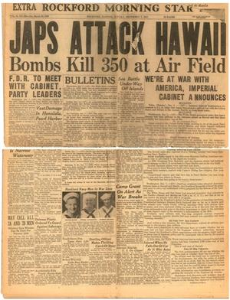
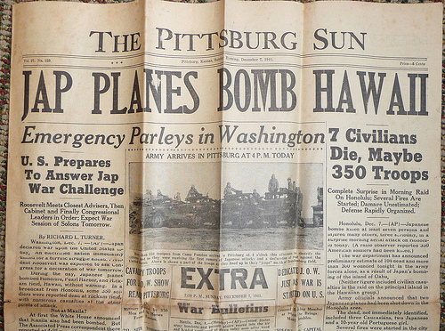
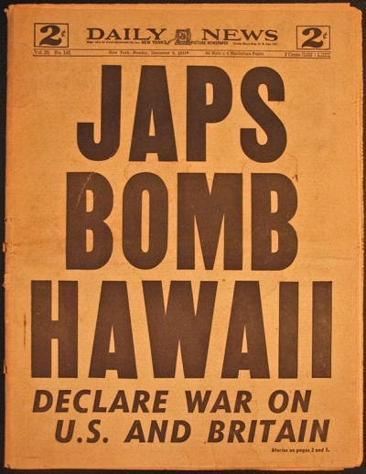
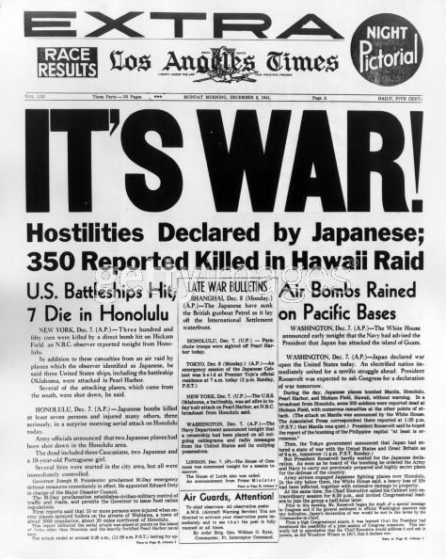
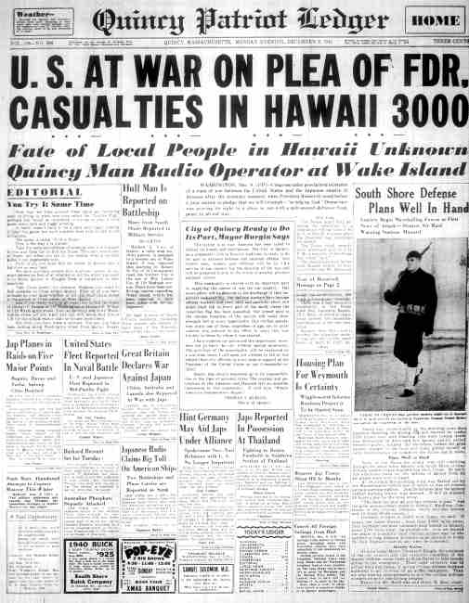
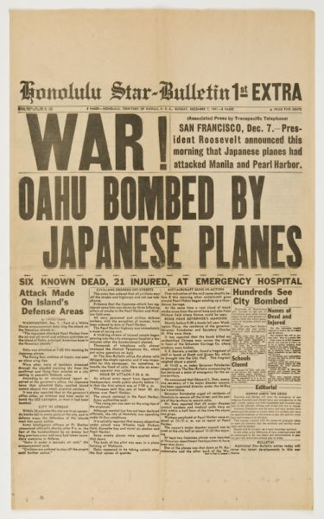
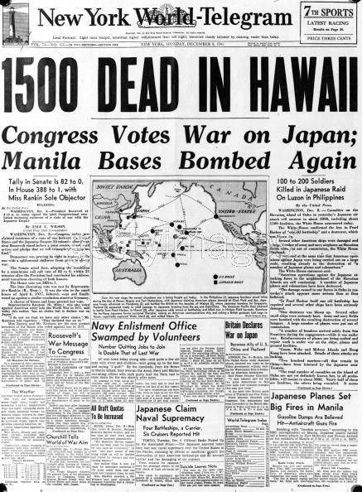
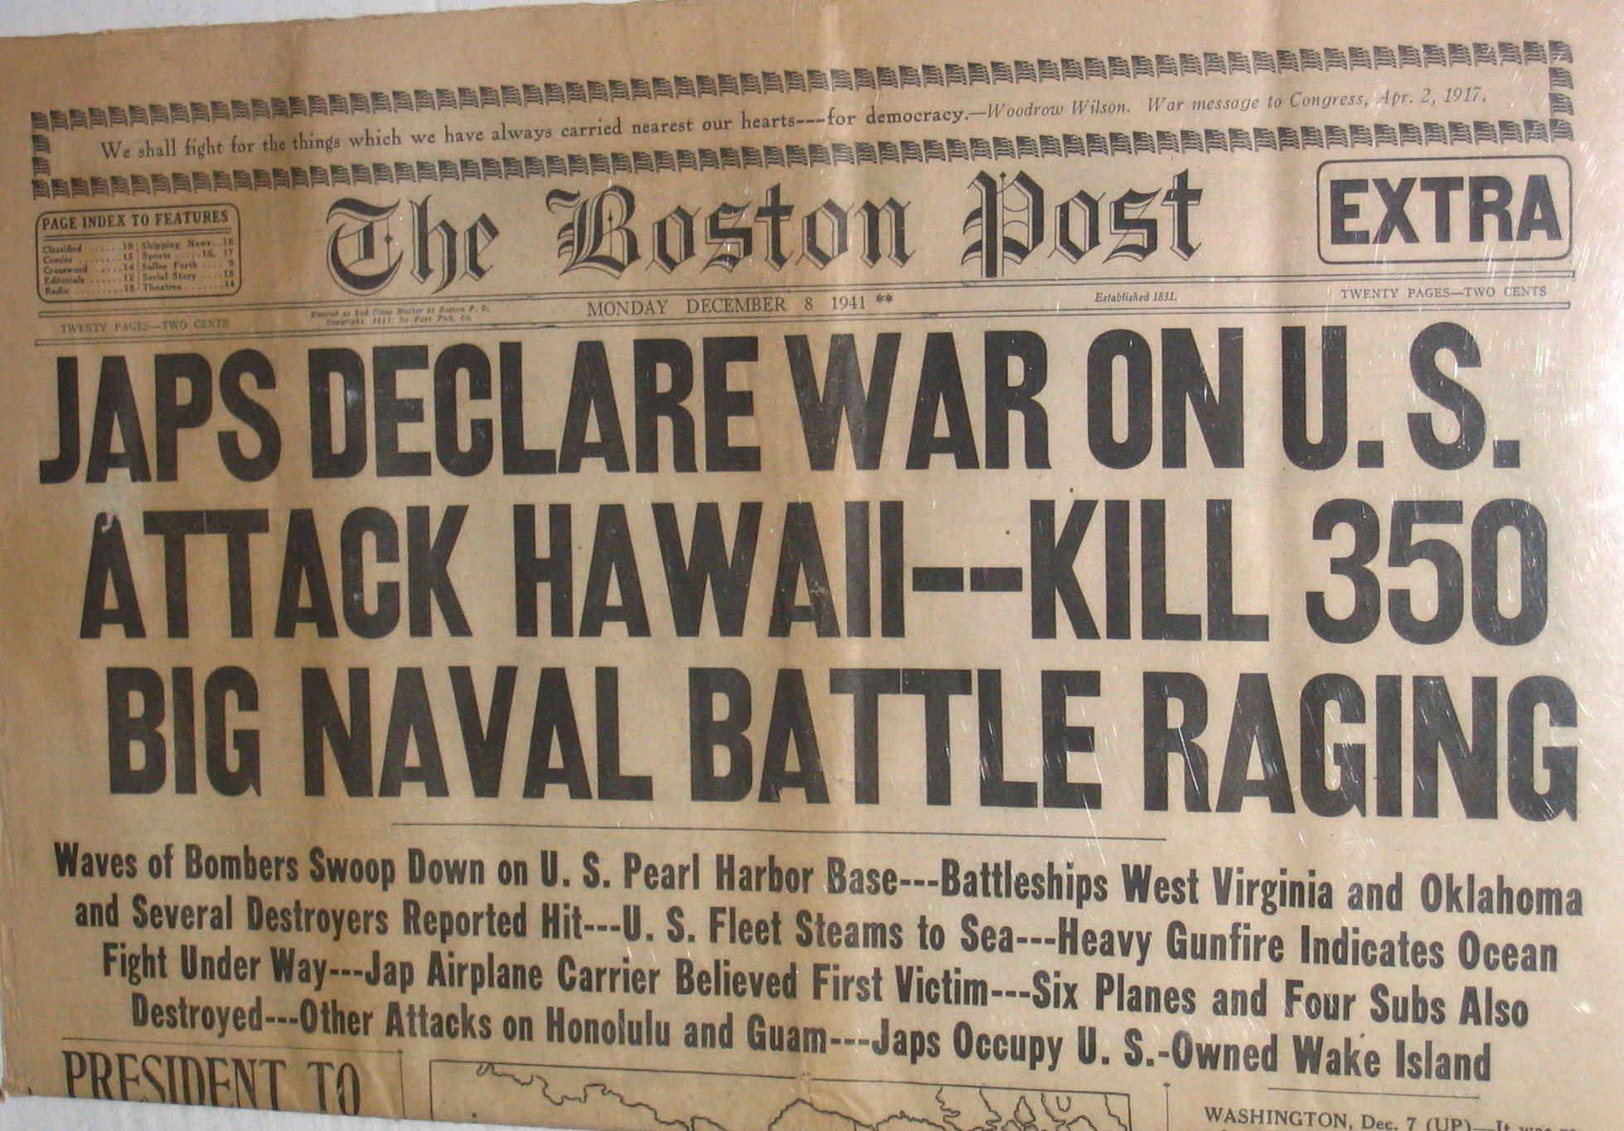
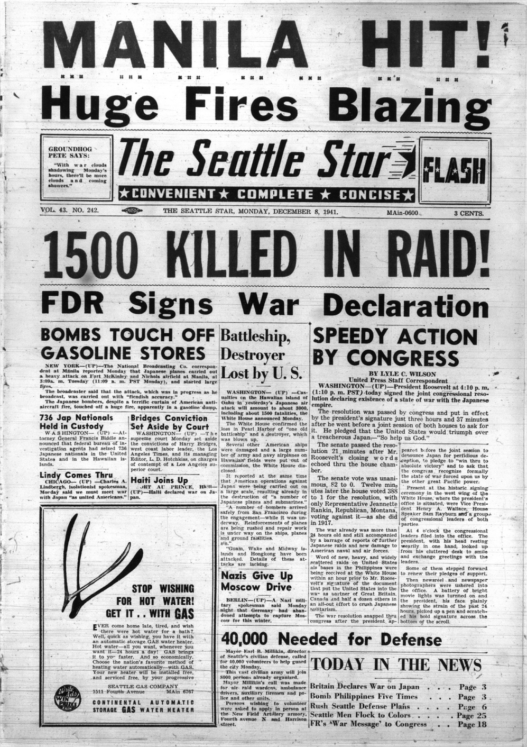
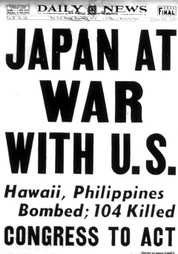
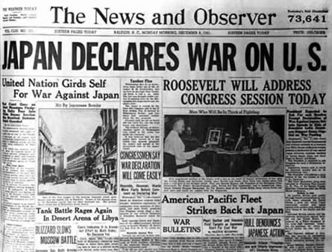
December 7, 1941

Slide 23
Part Three:
“I fear all we have done is awaken a sleeping giant, and filled it with a terrible resolve.”
Attributed to Admiral Isoroku Yamamoto
December 7, 1941
The Giant Awakens

